Slide 1

EE538 project: Trojan Map
Manoj Sunkara, Biyao Liang

Slide 2
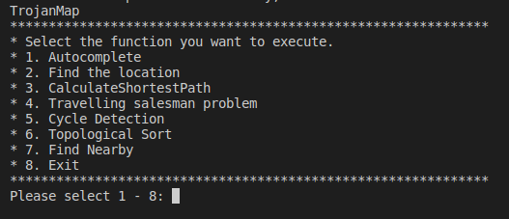
Project Overview
1. Autocomplete
2. Find the location
3. Calculate Shortest Path
4. Travelling salesman problem
5. Cycle Detection
6. Topological Sort
7. Find Nearby

Slide 3

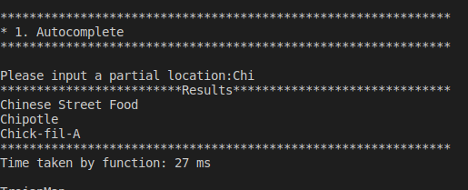
Autocomplete
Runtime Estimation:
O(n)*O(location name size)
Best case:
O(n)
Worst case: (if names are very long)
O(n*word_size)

Slide 4
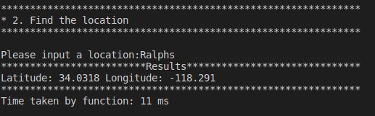
Find Location
Runtime Estimation:
O(n)

Slide 5
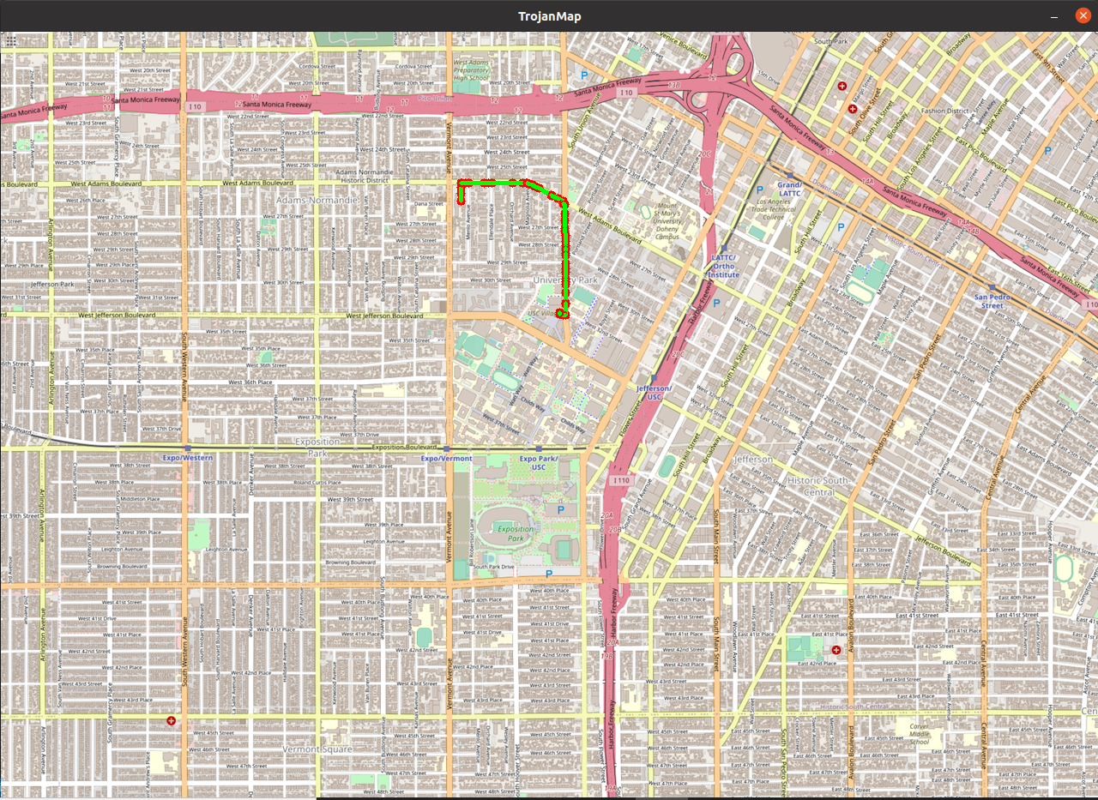
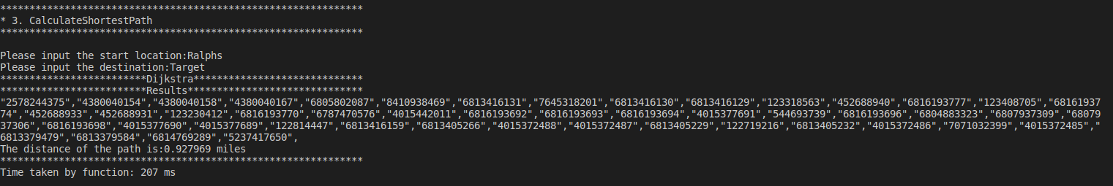
Calculate Shortest Path - Dijkstra
Runtime Estimation:
O((v+e)log(v))
Space: O(V+E) -> O(E)

Slide 6
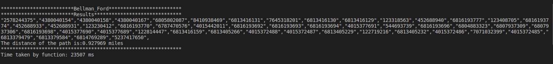
Calculate Shortest Path - Bellman-Ford
Runtime Estimation:
O(V*E) - time complexity
O(V) - space complexity

Slide 7
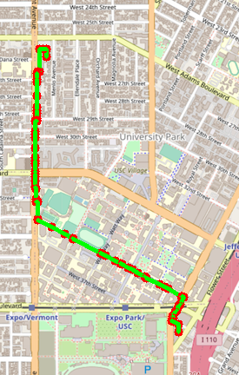
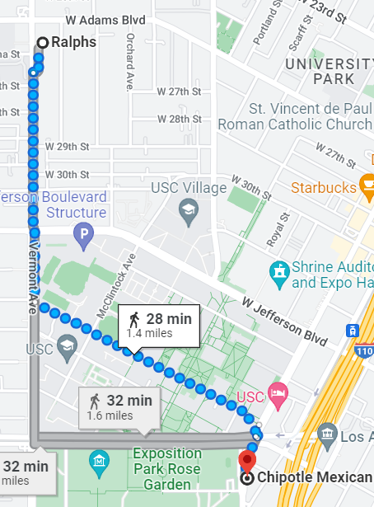
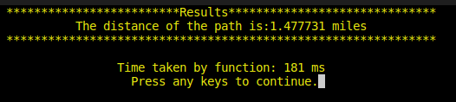

Slide 8
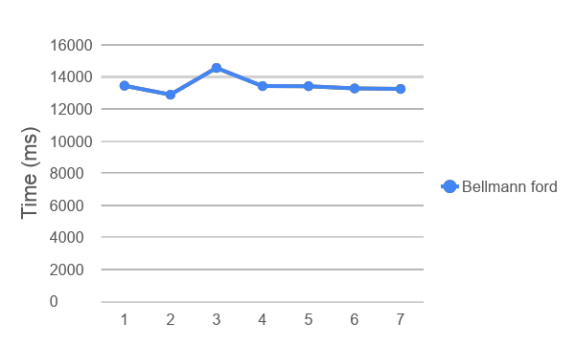
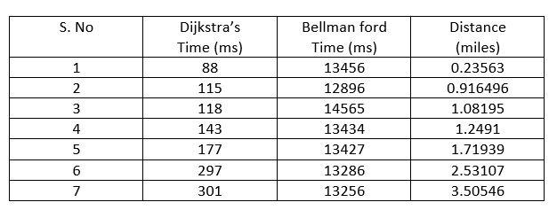
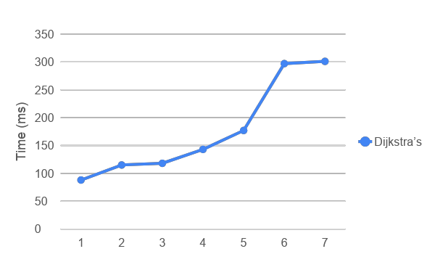
Performance Overview - shortest path

Slide 9


Traveling Trojan (Traveling Salesman)
Brute Force
Early-backtracking
2 opt
Runtime Estimation:
O(n!)
Runtime Estimation:
worst case:
O(n!) - just like brute force
Runtime Estimation:
O(n^2)
*note that 2opt does not give the best solution, only a good solution.

Slide 10
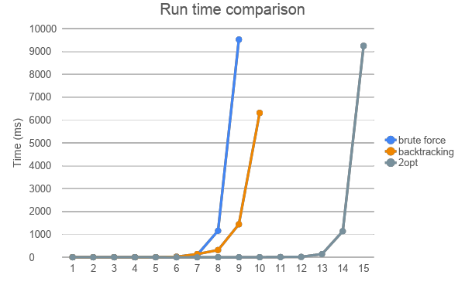
Traveling Trojan - performance comparison
N | Brute-force (ms) | Backtracking (ms) | 2opt (ms)
2 | 0 | 0 | 0
3 | 0 | 0 | 0
4 | 0 | 0 | 0
5 | 0 | 0 | 0
6 | 1 | 2 | 0
7 | 13 | 21 | 0
8 | 109 | 138 | 0
9 | 1158 | 314 | 0
10 | 9521 | 1442 | 1
11 | - | 6312 | 1
20 | - | - | 8
25 | - | - | 17
50 | - | - | 139
100 | - | - | 1137
200 | - | - | 9245

Slide 11
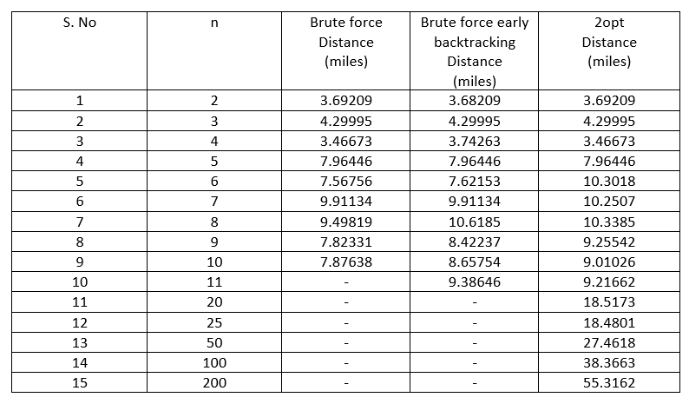
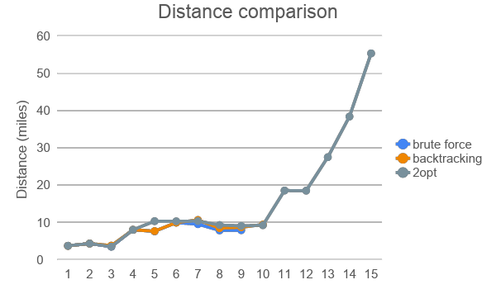
Traveling Trojan - performance comparison

Slide 12
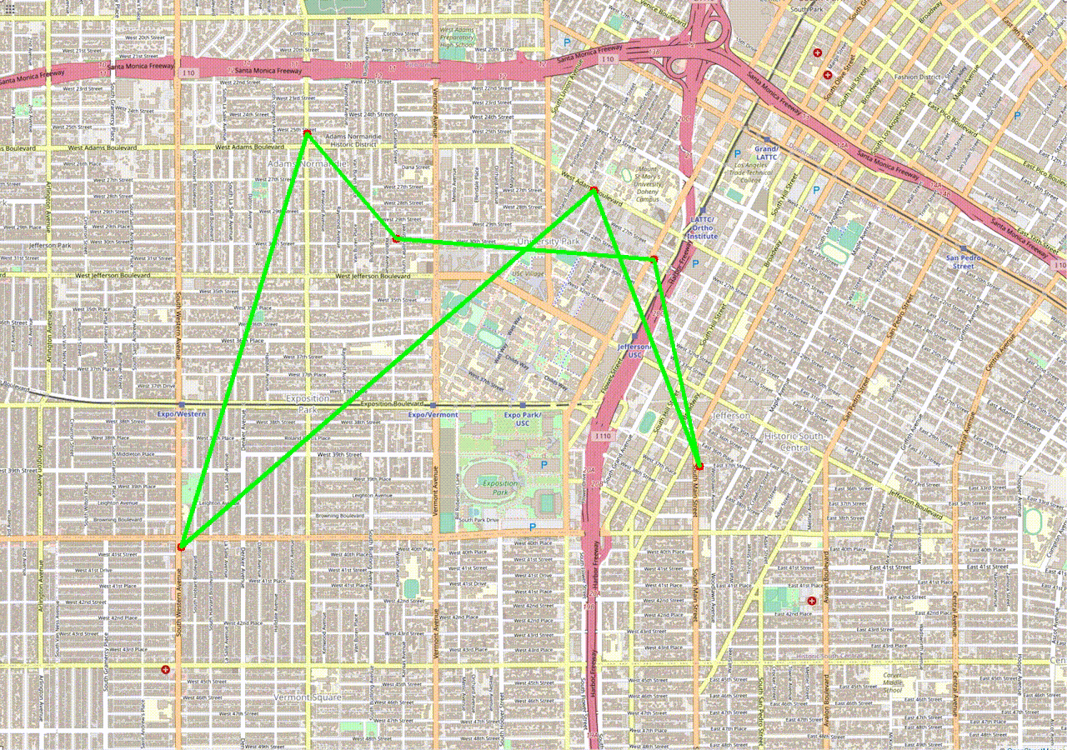

Slide 13
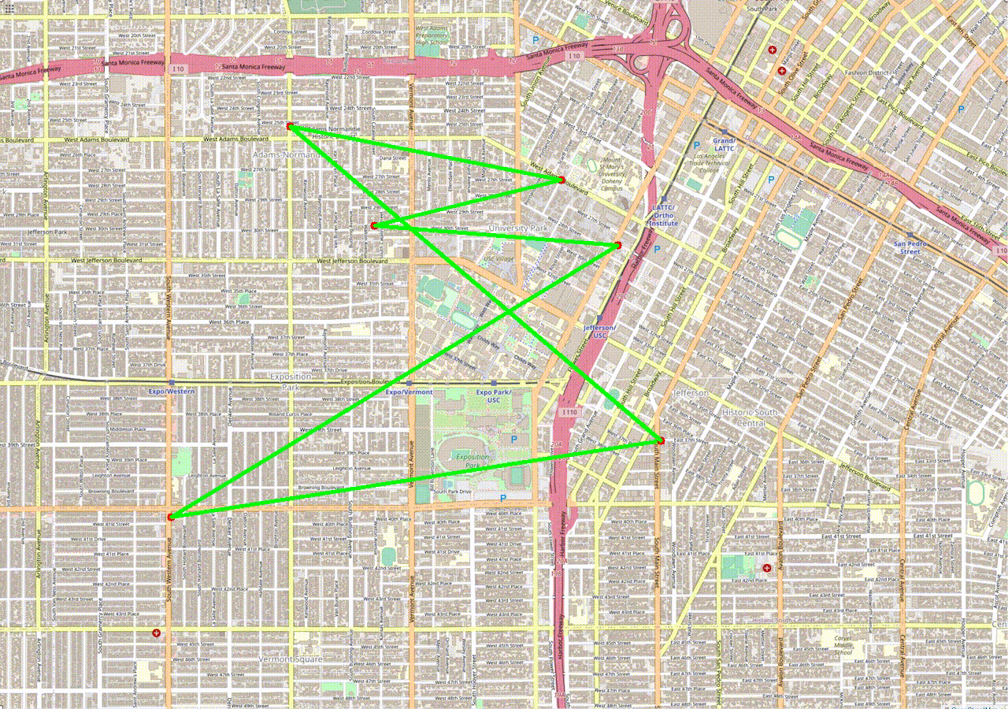

Slide 14
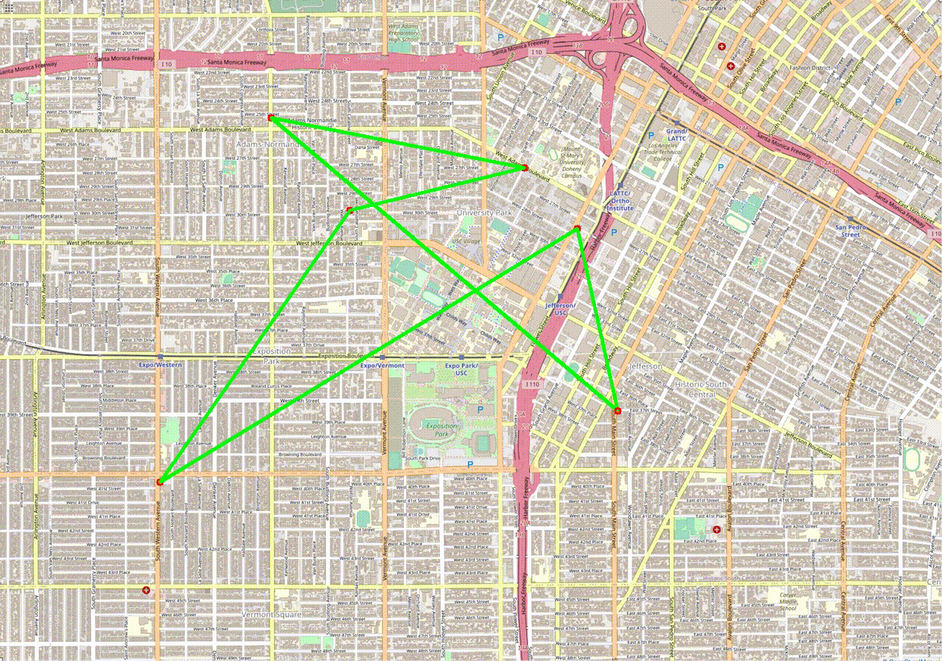

Slide 15
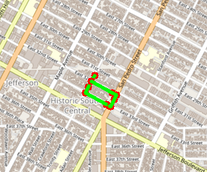
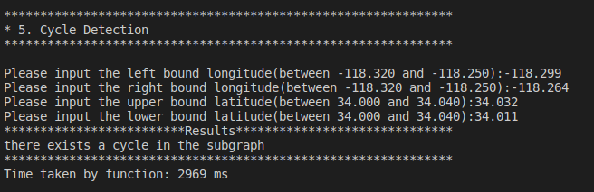
Cycle Detection
Runtime Estimation:
O(V + E )

Slide 16
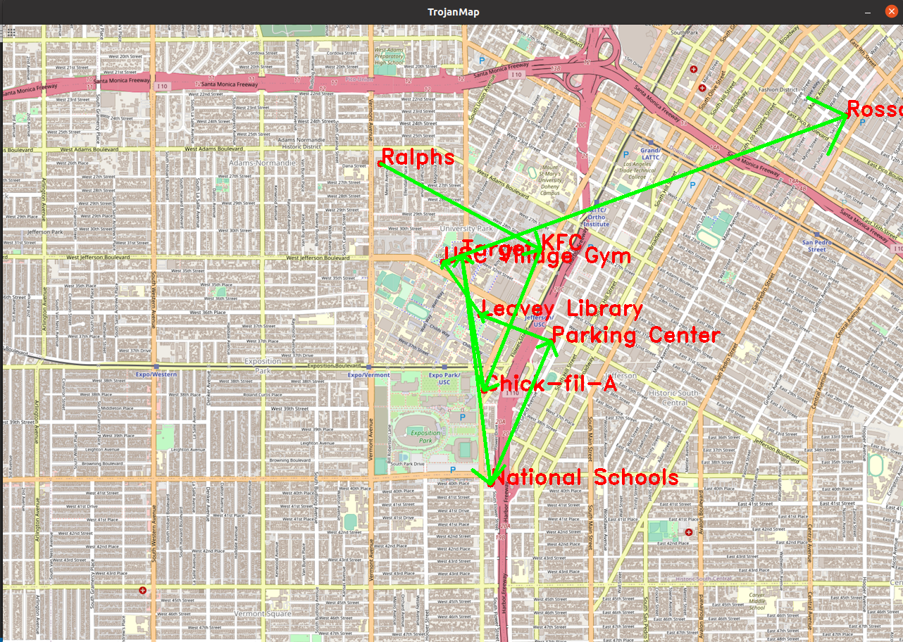

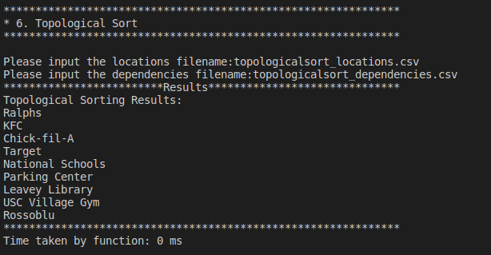
Topological Sort
Runtime Estimation:
O(E + V)
If the dependencies draws a cycle, then there is no possible topological order.

Slide 17
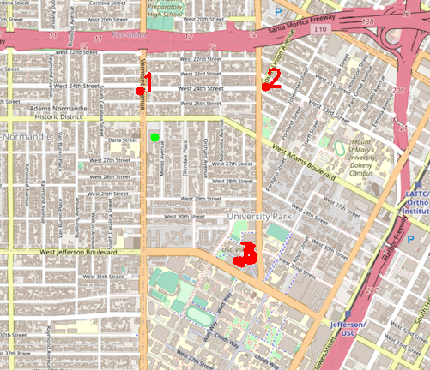
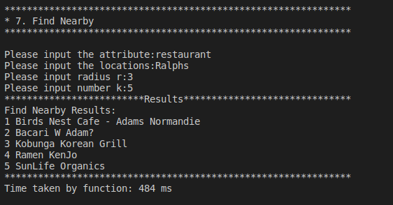
Find Nearby
Runtime Estimation:
O(V+nlog(n))
where V is the total number of nodes,
and n is the total number of entries in results.
nlog(n) is runtime of std::sort.

Slide 18

Interesting finds and lessons
Practiced our skills in using version control software in collaboration
Heuristics: sometimes a good solution is enough
It more than finding the correct answers: efficiency, space, stability
Future work:
3-opt in addition to 2-opt for traveling salesman
Graphic user interface
Other shortest path algorithms

Slide 19
Questions?

